Slide 1
CH 3: Agile Development
Course Supervisor: Syeda Nazia Ashraf
Software Engineering: A Practitioner’s Approach, 7/e
by Roger S. Pressman

Slide 2
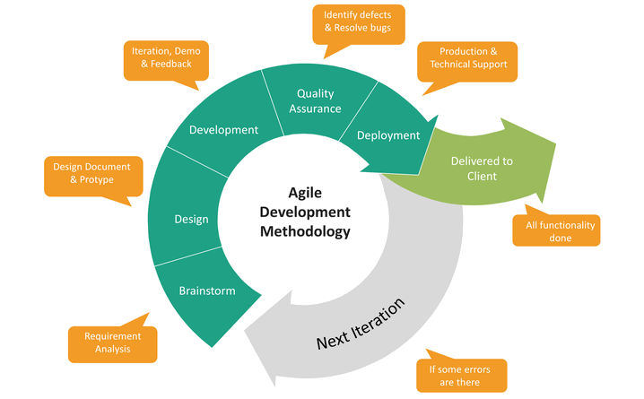
The Manifesto for Agile Software Development
“We are uncovering better ways of developing software by doing it and helping others do it. Through this work we have come to value:
Individuals and interactions over processes and tools
Working software over comprehensive documentation
Customer collaboration over contract negotiation
Responding to change over following a plan
That is, while there is value in the items on the right, we value the items on the left more.”
Kent Beck et al

Slide 3
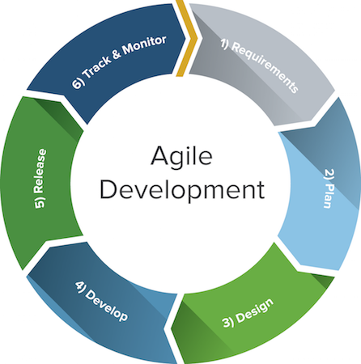
What is “Agility”?
Effective (rapid and adaptive) response to change (team members, new technology, requirements)
Effective communication among all team members (technological and business people, software engineers and Managers).
Drawing the customer into the team. Eliminate “us and them” attitude.
Organizing a team so that it is in control of the work performed
Yielding …!
Rapid, incremental delivery of software

Slide 4
Why and What Steps are “Agility” important?
Why? The modern business environment is fast-paced and ever-changing. It represents a reasonable alternative to conventional software engineering for certain classes of software projects. It has been demonstrated to deliver successful systems quickly.
What? May be termed as “software engineering lite” The basic activities- communication, planning, modeling, construction and deployment remain. But they morph into a minimal task set that push the team toward construction and delivery sooner.
The only really important work product is an operational “software increment” that is delivered.

Slide 5
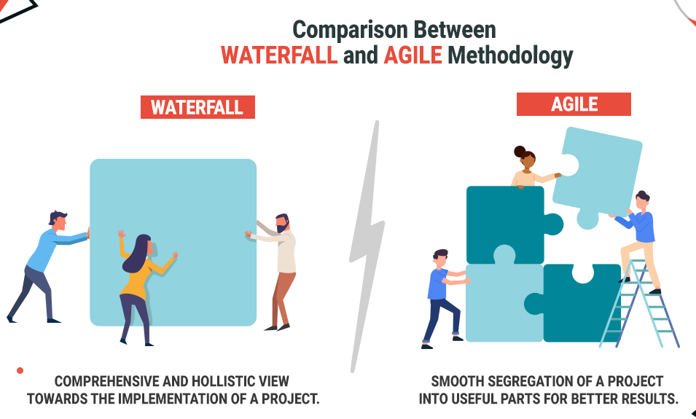

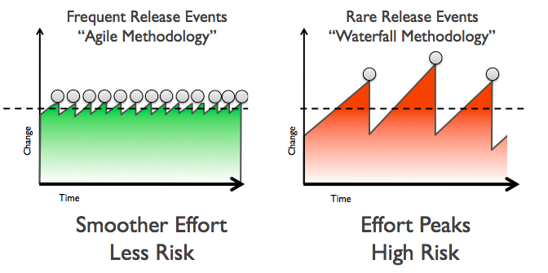
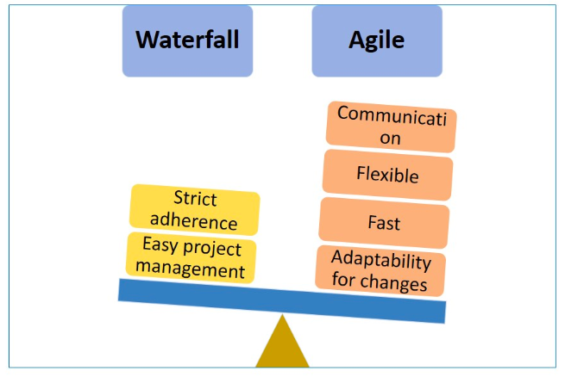
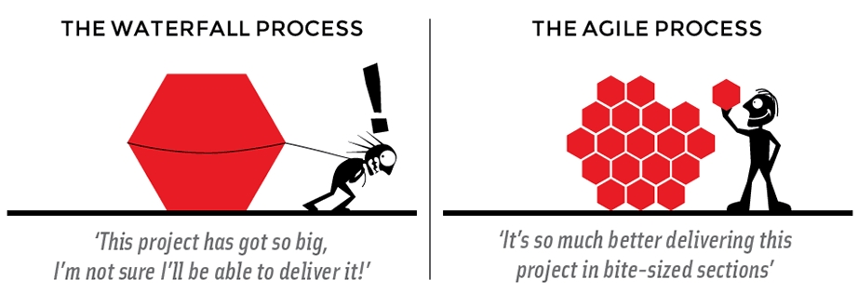

Slide 6
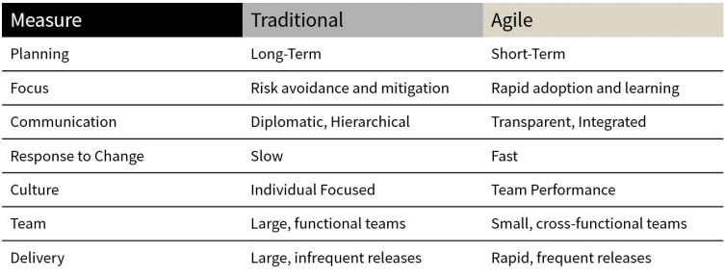
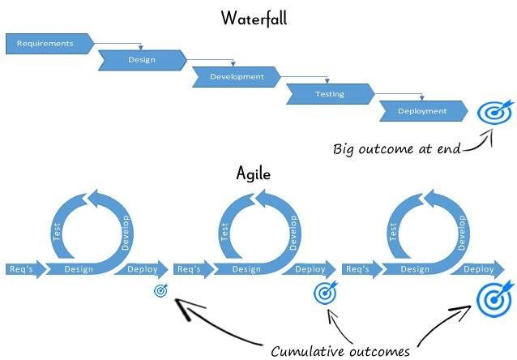
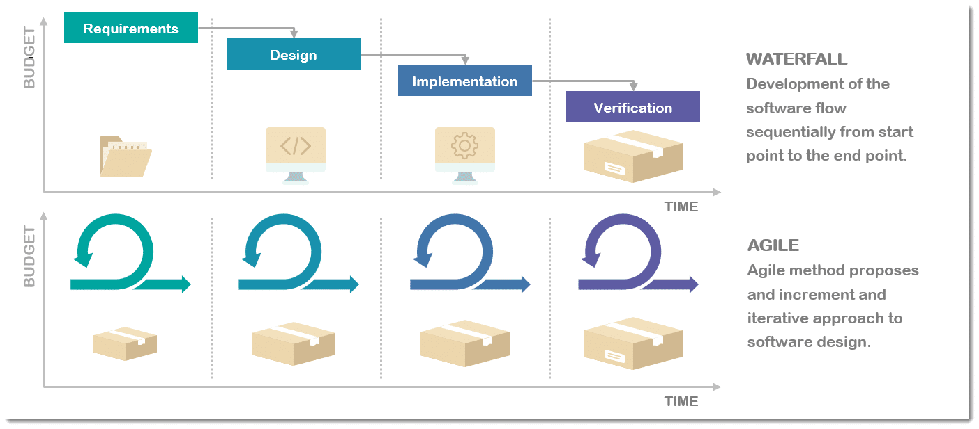
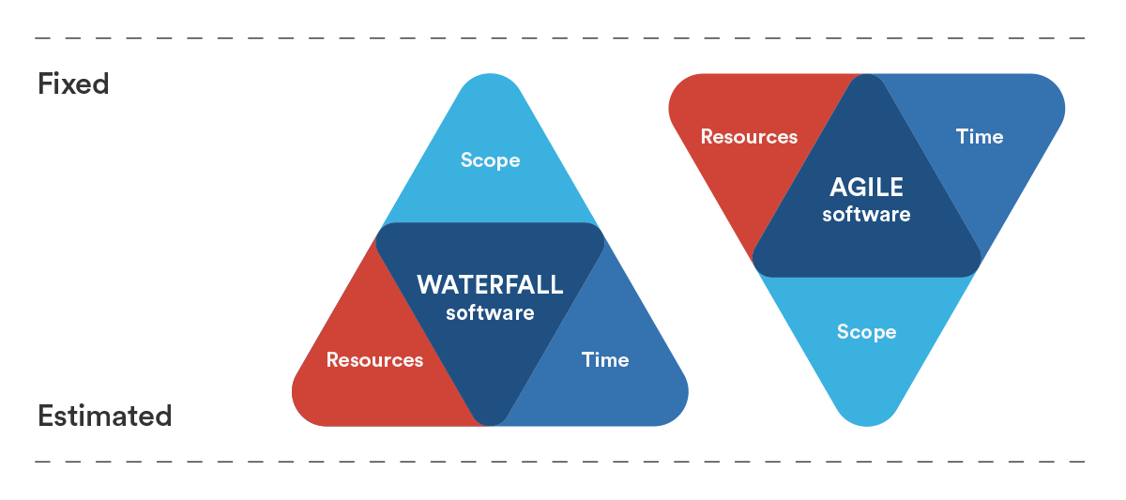

Slide 7
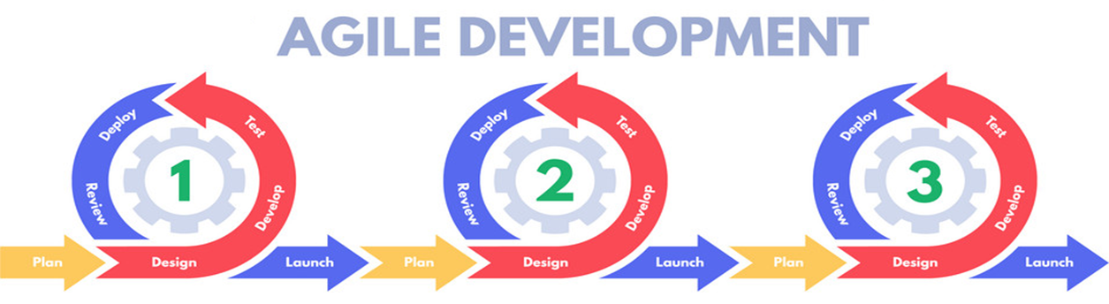
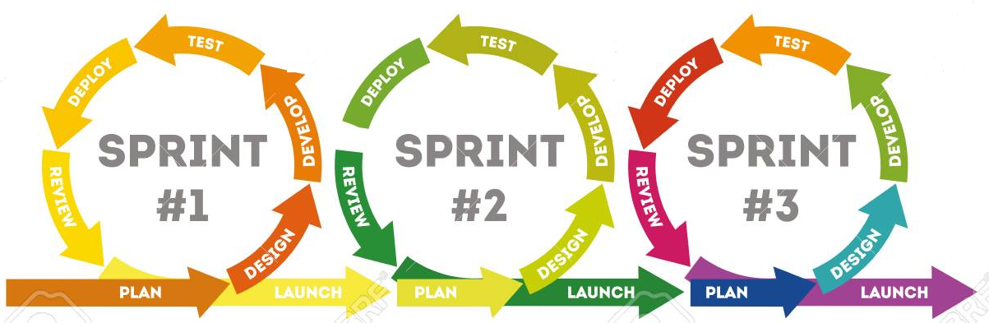

Slide 8
An Agile Process
Is driven by customer descriptions of what is required (scenarios). Some assumptions:
Recognizes that plans are short-lived (some requirements will persist, some will change. Customer priorities will change)
Develops software iteratively with a heavy emphasis on construction activities (design and construction are interleaved, hard to say how much design is necessary before construction. Design models are proven as they are created. )
Analysis, design, construction and testing are not predictable.
Thus has to Adapt as changes occur due to unpredictability
Delivers multiple ‘software increments’, deliver an operational prototype or portion of an OS to collect customer feedback for adaption.

Slide 9
Agility Principles - I
1. Our highest priority is to satisfy the customer through early and continuous delivery of valuable software.
2. Welcome changing requirements, even late in development. Agile processes harness change for the customer's competitive advantage.
3. Deliver working software frequently, from a couple of weeks to a couple of months, with a preference to the shorter timescale.
4. Business people and developers must work together daily throughout the project.
5. Build projects around motivated individuals. Give them the environment and support they need, and trust them to get the job done.
6. The most efficient and effective method of conveying information to and within a development team is face–to–face conversation.

Slide 10
Agility Principles - II
7. Working software is the primary measure of progress.
8. Agile processes promote sustainable development. The sponsors, developers, and users should be able to maintain a constant pace indefinitely.
9. Continuous attention to technical excellence and good design enhances agility.
10. Simplicity – the art of maximizing the amount of work not done – is essential.
11. The best architectures, requirements, and designs emerge from self–organizing teams.
12. At regular intervals, the team reflects on how to become more effective, then tunes and adjusts its behavior accordingly.
Not every agile process model applies these 12 principles with equal weight, and some models choose to ignore (or at least downplay) the importance of one or more of the principles.

Slide 11
Human Factors
“Agile development focuses on the talents and skills of individuals, molding the process to specific people and teams.”
The key point in this statement is that the process molds to the needs of the people and team, not the other way around.
key traits must exist among the people on an agile team and the team itself:
Competence. ( talent, skills, knowledge)
Common focus. ( deliver a working software increment )
Collaboration. ( peers and stakeholders)
Decision-making ability. ( freedom to control its own destiny)
Fuzzy problem-solving ability.(ambiguity and constant changes, today problem may not be tomorrow’s problem)
Mutual trust and respect.(a “jelled team” which is “so strongly knit that the whole is greater than the sum of the parts.”)
Self-organization. ( organize themselves for the work done, organize process for its local environment, organize the work schedule)

Slide 12
Agile Model - Pros and Cons
Agile methods are being widely accepted in the software world recently. However, this method may not always be suitable for all products. Here are some pros and cons of the Agile model.
The advantages of the Agile Model are as follows:
It is a very realistic approach to software development.
Promotes teamwork and cross training.
Functionality can be developed rapidly and demonstrated.
Resource requirements are minimum.
Suitable for fixed or changing requirements
Delivers early partial working solutions.
Good model for environments that change steadily.
Minimal rules, documentation easily employed.
Enables concurrent development and delivery within an overall planned context.
Little or no planning required.
Easy to manage.
Gives flexibility to developers.

Slide 13
Disadvantages of the Agile Model
Not suitable for handling complex dependencies.
More risk of sustainability, maintainability and extensibility.
An overall plan, an agile leader and agile PM practice is a must without which it will not work.
Strict delivery management dictates the scope, functionality to be delivered, and adjustments to meet the deadlines.
Depends heavily on customer interaction, so if customer is not clear, team can be driven in the wrong direction.
There is a very high individual dependency, since there is minimum documentation generated.
Transfer of technology to new team members may be quite challenging due to lack of documentation.

Slide 14
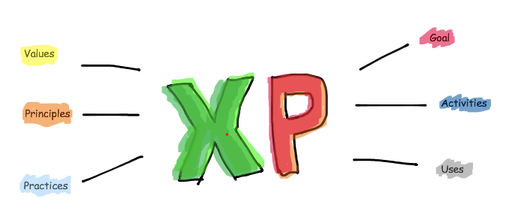
Extreme Programming (XP)
Extreme programming (XP) is one of the most important software development framework of Agile models.
It is used to improve software quality and responsive to customer requirements.
The extreme programming model recommends taking the best practices that have worked well in the past in program development projects to extreme levels.

Slide 15
Extreme Programming (XP)
Extreme Programming uses an object- oriented approach as its preferred development paradigm and encompasses a set of rules and practices that occur within the context of four framework activities: planning, design, coding, and testing.

Slide 16
Good practices needs to practiced XP
Some of the good practices that have been recognized in the extreme programming model and suggested to maximize their use are given below:
Code Review: Code review detects and corrects errors efficiently. It suggests pair programming as coding and reviewing of written code carried out by a pair of programmers who switch their works between them every hour.
Testing: Testing code helps to remove errors and improves its reliability. XP suggests test-driven development (TDD) to continually write and execute test cases. In the TDD approach test cases are written even before any code is written.
Incremental development: Incremental development is very good because customer feedback is gained and based on this development team come up with new increments every few days after each iteration.
Simplicity: Simplicity makes it easier to develop good quality code as well as to test and debug it.
Design: Good quality design is important to develop a good quality software. So, everybody should design daily.
Integration testing: It helps to identify bugs at the interfaces of different functionalities. Extreme programming suggests that the developers should achieve continuous integration by building and performing integration testing several times a day.

Slide 17
Basic principles of XP
XP is based on the frequent iteration through which the developers implement User Stories.
User stories are simple and informal statements of the customer about the functionalities needed. A User story is a conventional description by the user about a feature of the required system. It does not mention finer details such as the different scenarios that can occur.
On the basis of User stories, the project team proposes Metaphors. Metaphors are a common vision of how the system would work.
The development team may decide to build a Spike for some feature. A Spike is a very simple program that is constructed to explore the suitability of a solution being proposed. It can be considered similar to a prototype.

Slide 18
Basic principles of XP
Some of the basic activities that are followed during software development by using XP model are given below:
Coding: The concept of coding which is used in XP model is slightly different from traditional coding. Here, coding activity includes drawing diagrams (modeling) that will be transformed into code, scripting a web-based system and choosing among several alternative solutions.
Testing: XP model gives high importance on testing and considers it be the primary factor to develop a fault-free software.
Listening: The developers needs to carefully listen to the customers if they have to develop a good quality software. Sometimes programmers may not have the depth knowledge of the system to be developed. So, it is desirable for the programmers to understand properly the functionality of the system and they have to listen to the customers.
Designing: Without a proper design, a system implementation becomes too complex and very difficult to understand the solution, thus it makes maintenance expensive. A good design results elimination of complex dependencies within a system. So, effective use of suitable design is emphasized.
Feedback: One of the most important aspects of the XP model is to gain feedback to understand the exact customer needs. Frequent contact with the customer makes the development effective.
Simplicity: The main principle of the XP model is to develop a simple system that will work efficiently in present time, rather than trying to build something that would take time and it may never be used. It focuses on some specific features that are immediately needed, rather than engaging time and effort on speculations of future requirements.

Slide 19
Applications of Extreme Programming (XP)
Some of the projects that are suitable to develop using XP model are given below:
Small projects: XP model is very useful in small projects consisting of small teams as face to face meeting is easier to achieve.
Projects involving new technology or Research projects: This type of projects face changing of requirements rapidly and technical problems. So XP model is used to complete this type of projects.

Slide 20
Requirements scenarios
In XP, a customer or user is part of the XP team and is responsible for making decisions on requirements.
User requirements are expressed as scenarios or user stories.
These are written on cards and the development team break them down into implementation tasks. These tasks are the basis of schedule and cost estimates.
The customer chooses the stories for inclusion in the next release based on their priorities and the schedule estimates.

Slide 21
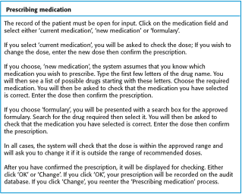
A ‘prescribing medication’ story

Slide 22
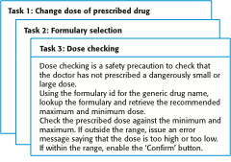
Examples of task cards for prescribing medication

Slide 24
Industrial XP
The most widely used of all agile process models is extreme programming (XP). But many other agile process models have been proposed and are in use across the industry. Among the most common are:
Adaptive Software Development (ASD)
Scrum
Dynamic System Development Method(DSDM)
Crystal
Feature Drive Development (FDD)
Lean Software Development (LSD)
Agile Modeling (AM)
Agile Unified Process (AUP)
All agile process models conform (to a greater or lesser degree) to the manifesto for agile software development and the principles said earlier.

Slide 25
Scrum (the name is derived from an activity occurs during a rugby match in early 1990).
Scrum principles are consistent with the agile manifesto and are used to guide development activities within a process that incorporates the following framework activities: requirements, analysis, design, evolution, and delivery.
Within each framework activity, work tasks occur within a process pattern (discussed in the next slide) called a sprint.

Slide 26
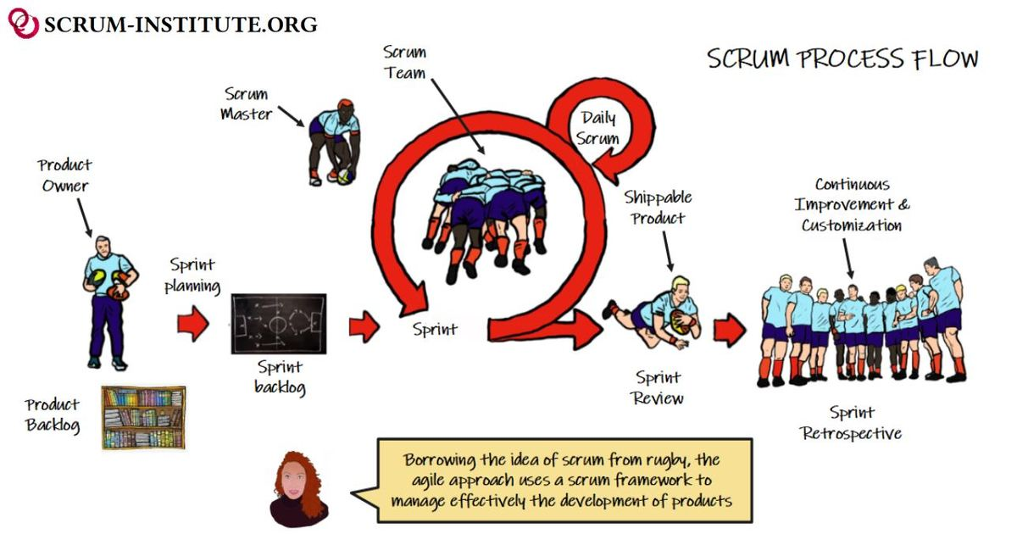

Slide 27
Scrum
A software development method Originally proposed by Schwaberand Beedle Scrum
—distinguishing features
Development work is partitioned into “packets”.
Testing and documentation are on-going as the product is constructed
Work units occurs in “sprints” and is delivered from a “backlog” of existing requirements.
Meetings are very short (15 minutes daily) and sometimes conducted without chairs ( what did you do since last meeting? What obstacles are you encountering? What do you plan to accomplish by next meeting?)
“demos” are delivered to the customer with the time-box allocated. May not contain all functionalities. So customers can evaluate and give feedbacks.

Slide 28
Scrum

Slide 29
Scrum
The Scrum approach is a general agile method but its focus is on managing iterative development rather than specific agile practices.
There are three phases in Scrum.
The initial phase is an outline planning phase where you establish the general objectives for the project and design the software architecture.
This is followed by a series of sprint cycles, where each cycle develops an increment of the system.
The project closure phase wraps up the project, completes required documentation such as system help frames and user manuals and assesses the lessons learned from the project.

Slide 30
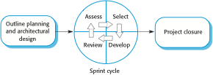
The Scrum process

Slide 31
The Sprint cycle
Sprints are fixed length, normally 2–4 weeks. They correspond to the development of a release of the system in XP.
The starting point for planning is the product backlog, which is the list of work to be done on the project.
The selection phase involves all of the project team who work with the customer to select the features and functionality to be developed during the sprint.

Slide 32
The Sprint cycle
Once these are agreed, the team organize themselves to develop the software. During this stage the team is isolated from the customer and the organization, with all communications channelled through the so-called ‘Scrum master’.
The role of the Scrum master is to protect the development team from external distractions.
At the end of the sprint, the work done is reviewed and presented to stakeholders. The next sprint cycle then begins.

Slide 33
Teamwork in Scrum
The ‘Scrum master’ is a facilitator who arranges daily meetings, tracks the backlog of work to be done, records decisions, measures progress against the backlog and communicates with customers and management outside of the team.
The whole team attends short daily meetings where all team members share information, describe their progress since the last meeting, problems that have arisen and what is planned for the following day.
This means that everyone on the team knows what is going on and, if problems arise, can re-plan short-term work to cope with them.

Slide 34
Scrum benefits
The product is broken down into a set of manageable and understandable chunks.
Unstable requirements do not hold up progress.
The whole team have visibility of everything and consequently team communication is improved.
Customers see on-time delivery of increments and gain feedback on how the product works.
Trust between customers and developers is established and a positive culture is created in which everyone expects the project to succeed.

Slide 35
Reading Assignment
Adaptive Software Development(ASD)
Dynamic Systems Development Method(DSDM)
Crystal
Agile Modeling (AM)
Feature Driven Development (FDD)
Lean Software Development (LSD)
Agile Unified Process (AUP)

